Slide 1
Pre-lecture 9 and 10: Multilevel modelling How to read design formula syntax
Notes:
Hi everyone, this week we’re going to be talking more about multilevel modelling – this is a quick recap and explainer of how each of these models is written in r’s design formula syntax. This is not essential material for acing the course, but it might at least vaguely interest some of you, and I think it will help you understand what we’re doing with MLM

Slide 2
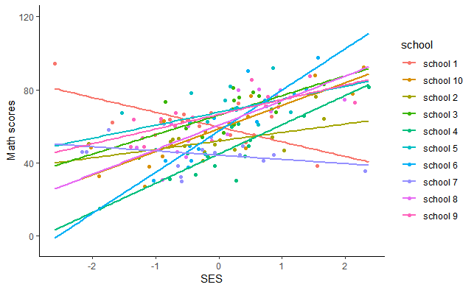
Our eventual regression model
Y_{ij} = γ₀₀ + γ₁₀x_{ij} + u_{0j} + u_{1j}x_{ij} + ε_{ij}
math ~ 1 + ses + (1 + ses | school)
Notes:
We’re going to work our way back up to this model here, and by the end of this video you will, with a bit of luck, be able to read both of these equations. The top is the more traditional way of writing this, the bottom is R’s design formula syntax

Slide 3
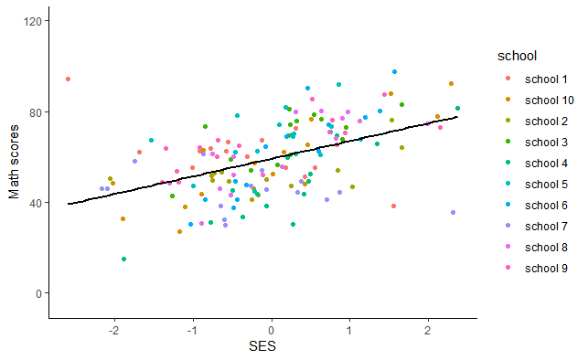
Simple regression model
Y_{ij} = β₀ + β₁₀X_{ij} + ε_{ij}
math ~ 1 + ses
Notes:
We’re going to start off thinking just of simple regression. I’m going you can see we are predicting y, math scores, with an intercept, a regression coefficient time X, SES, and we include an error term as our predictions will not be perfect. In r’s syntax, this is simply written as math ~ (tilde, basically we just just think “equals” 1 (which is indicative of the intercept, here in green) plus SES, in red. In r’s design formula syntax we can just ignore the error term

Slide 4
Simple regression model
Notes:
We can run this in r after reading in our data using the lm command, which just runs simple regression Here I save the model as mod 1, say that math is predicted by ses, and here I add in an intercept, even though it’s not strictly necessary, and also tell the function that my data is called “mathDat”. After running the function and saving it as mod1, we can take a look at the output by running the summary function on mod1. So, we can see that a one unit increase in SES leads to a 7.8 unit predicted increase in math scores, from an intercept of 59.1

Slide 5
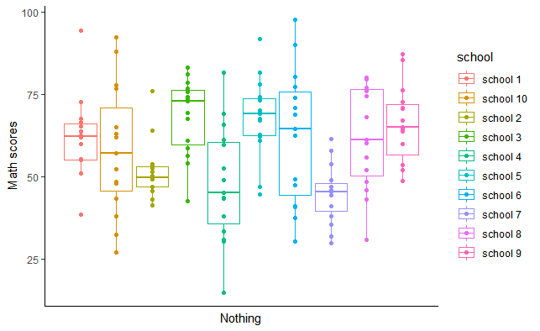
Random effects ANOVA
Y_{ij} = γ₀₀ + γ₁₀x_{ij} + u_{0j} + u_{1j}x_{ij} + ε_{ij}
math ~ 1 + (1 | school)
Notes:
In random effects ANOVAs we’re only interested in whether the overall scores differ by group – Notice that there is nothing on the y axis, there’s no regression slope, just gamma 00 an overall intercept, and a random effect / a random intercept for group. So here, in r’s syntax, we just write math ~ 1 (for the intercept) + open brackers, 1 bar school, close brackets. We’re saying that for each school, we allow the intercept to vary.

Slide 6
Random effects ANOVA
Y_{ij} = γ₀₀ + γ₁₀x_{ij} + u_{0j} + u_{1j}x_{ij} + ε_{ij}
math ~ 1 + (1 | school)
Notes:
In random effects ANOVAs we’re only interested in whether the overall scores differ by group – Notice that there is nothing on the y axis, there’s no regression slope, just gamma 00 an overall intercept, and a random effect / a random intercept for group. So here, in r’s syntax, we just write math ~ 1 (for the intercept) + open brackers, 1 bar school, close brackets. We’re saying that for each school, we allow the intercept to vary.

Slide 7
Running a random effects ANOVA in R
Notes:
We can run this model in R using the lme4 linear mixed effects models packahe, and getting statistical tests and some other accoutrement using lmerTest. Then we can run this model, saying math is predcited by an intercept plus a random effect for school – i.e., letting the intercepts differ by school, saving it as mod2, and then get a model summary using the summary function Good, well we can see some nice output there, but maybe we want to take a look at the ICC – we can either use the sjstasts package to get the ICC function to get the icc with the icc function, which you can see here. The icc is the proportion of variance attributable to the grouping structure as a proportion of the total variance .22 is pretty high, so the grouping structure is important indeed.
We could also have just calculate it by hand – you can see just copying and pasting from above gets us the same answer after accounting for rounding .

Slide 8
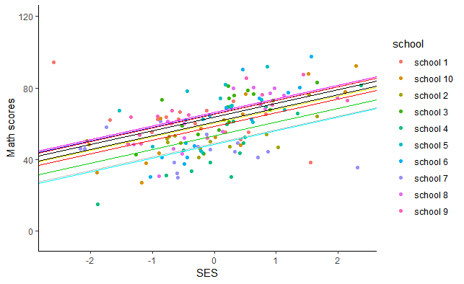
Random intercepts model
Y_{ij} = γ₀₀ + γ₁₀x_{ij} + u_{0j} + ε_{ij}
Notes:
A random intercepts models assumes the slope is the same for everyone, but lets the intercepts differ by group. We can see this is math score for person I in group j = gamma 00 (an intercept for everyone) + gamma 10 times a person’s score on ses (a regression slope for person) + a random effect for each group + a residual for each person The only new part in the random slopes model is that we have the regression slope for the relationship between SES and math scores

Slide 9
One regression model
Y_{ij} = γ₀₀ + γ₁₀x_{ij} + u_{0j} + u_{1j}x_{ij} + ε_{ij}
y ~ 1 + x + (1 + x | group)
Notes:
If we use traditional regression we are almost certainly violating one of the major assumptions of regression – that variables are independently and identically distributed – the nested sampling means that individuals from the same school are not independent of one another. The schools probably have some impact on the Math scores of the kids, and there are also almost certainly differences between schools in the average level of SES.

Slide 10
Multilevel models
math_{ij} = γ₀₀ + γ₁₀ses_{ij} + u_{1j}ses_{ij} + u_{0j} + ε_{ij}
Notes:
Let’s make the math into something slightly more comprehendible
This means that person I in group j’s score is equal to and overall intercept, gamma00, plus a regression slope, gamma 10, times their SES score, plus U1j times their SES score, meaning a random effect for group times their SES score – the U1j value is a random effect, meaning that we assume that each group has a different value for u – plus U0j which lets the intercepts differ by group but does not impact the slopes,
plus an error term for each person

Slide 11
Regression models for each school
math_{ij} = 50 + 7 × ses_{ij} + u_{1j}ses_{ij} + u_{0j} + ε_{ij}
math_{ij} = γ₀₀ + γ₁₀ses_{ij} + u_{1j}x _{ij} + u_{0j} + ε_{ij}
Notes:
Lets get our model estimates our. We get values for the fixed effects, but do not get values for the random effects (as they are assumed to differ by group). Instead we will get estimates of how much each of those u’s varies. This means that we can say that person I in group j’s math score is equal to 50, the overall intercept, plus 7 times their ses score, Plus a random effect times their SES score – again, this allows the relationship between SES and math scores to change by group – the random slopes of it all Plus a random effect for each group – this means that we can let the purple group here’s intercept be different from the red group’s for example.

Slide 12
Random effects ANOVA
Y_{ij} = γ₀₀ + u_{0j} + ε_{ij}
Notes:
In random effects ANOVAs we’re only interested in whether the overall scores differ by group – Notice that there is nothing on the y axis, there’s no regression slope, just gamma 00 an overall intercept, and a random effect / a random intercept for group.

Slide 13
Random intercepts model
Y_{ij} = γ₀₀ + γ₁₀x_{ij} + u_{0j} + ε_{ij}
Notes:
A random intercepts models assumes the slope is the same for everyone, but lets the intercepts differ by group. We can see this is math score for person I in group j = gamma 00 (an intercept for everyone) + gamma 10 times a person’s score on ses (a regression slope for person) + a random effect for each group + a residual for each person The only new part in the random slopes model is that we have the regression slope for the relationship between SES and math scores

Slide 14
Random slopes and intercepts model
Y_{ij} = γ₀₀ + γ₁₀x_{ij} + u_{1j}x_{ij} + u_{0j} + ε_{ij}
Notes:
And finally, a random slopes model allows for different intercepts and different slopes – we can see this as person I in group j’s math score = gamma 00 (and intercept for everyone) + gamma 10 times a person’s score on ses (which is a regression slope that applies to everyone) + a random effect for group times SES, which allows for the relationship between SES and math scores to change by group + plus a random effect for each group (letting group intercepts change) + a residual for each person The only new part for the random slopes model is u_{1j}x_{ij} – the random effects times the person level IV, in our case SES, which lets the slopes vary by group! In week 10’s lecture we’ll even go beyond this

Slide 15
One regression model
Y_{ij} = γ₀₀ + γ₁₀x_{ij} + u_{0j} + u_{1j}x_{ij} + ε_{ij}
y ~ 1 + x + (1 + x | group)
Notes:
If we use traditional regression we are almost certainly violating one of the major assumptions of regression – that variables are independently and identically distributed – the nested sampling means that individuals from the same school are not independent of one another. The schools probably have some impact on the Math scores of the kids, and there are also almost certainly differences between schools in the average level of SES.

